Slide 1

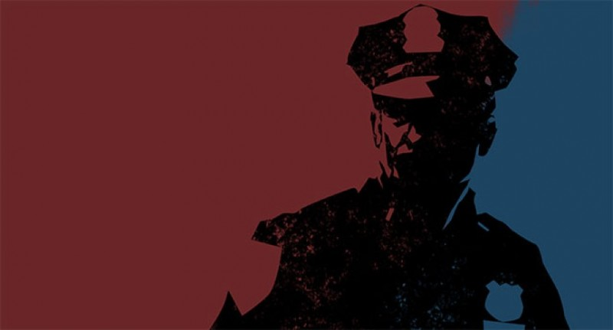

Determinants of Body Camera Usage during Fatal Police Shootings in the United States (2015-2022) Team 7 Final Project Alex Khater, Rajeev Koneru, Cora Martin

Slide 2
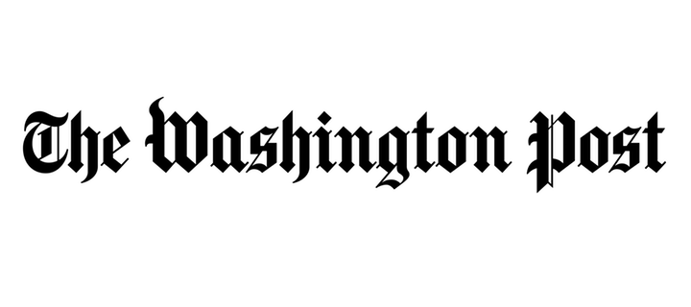
Midterm Recap: Data Set Information
In response to a severe lack of reporting within government sources, The Washington Post compiled a database of every fatal police shooting in the United States from 2015-2022. We are interested in exploring this data, specifically as it relates to differences between U.S. states and regions.
After accounting for null values, the data set we are working with has 6,574 observations. Below we have provided a sample row of the data:
Name | Date | Manner of Death | Armed | Age | Gender
Tim Elliot | 10/04/2022 | Shot | Gun | 53 | M
Race | City | State | Signs of Mental Illness | Threat Level | Flee
A | Shelton | WA | 1 | TRUE | Not fleeing
Body Camera | Longitude | Latitude | Is Geocoding Exact
FALSE | -123 | 47.2 | TRUE

Slide 3
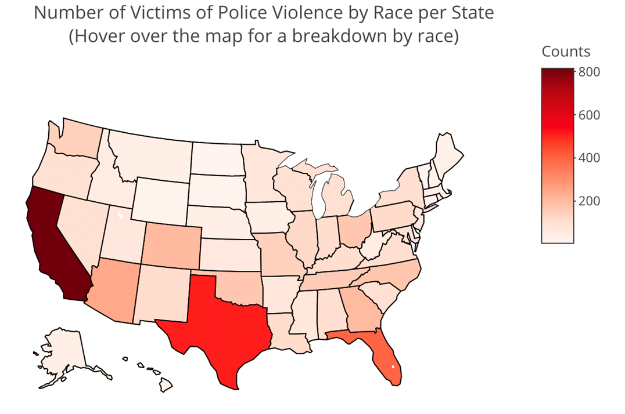
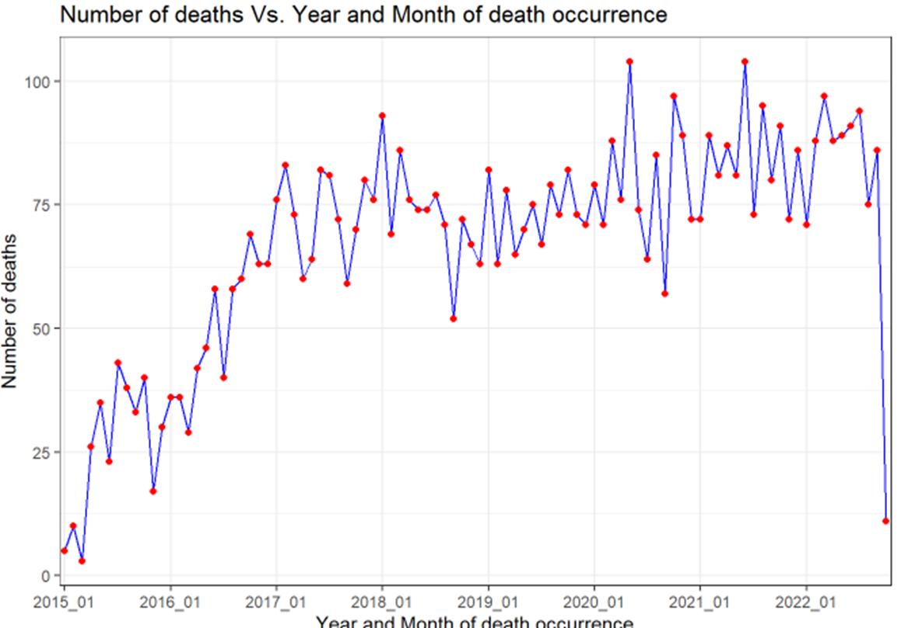
Midterm Recap: EDA

Slide 4
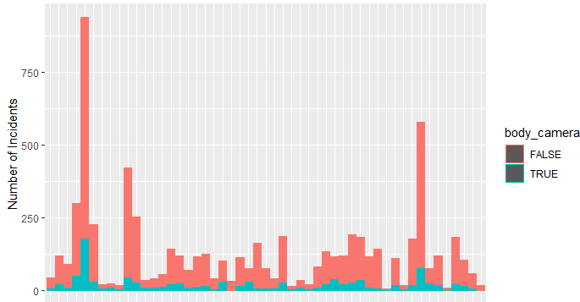
Midterm Recap: SMART Q Findings
fff
After reshaping our data to be by state, we performed analysis and found there to be a significant difference between states’ proportion of capturing incidences of police shootings on body camera
Can we see what causes this difference ? ...

Slide 5
Final SMART Research Question
For the years 2021 and 2022, do: US Region, Law Enforcement Officers per capita, Law Enforcement spending per capita, body camera mandate laws, and 2020 presidential election leaning have any large influence on a state's proportion of body camera usage ?
S
This question is using specific types of model to measure a specific numeric quantity (state body cam proportion) over a specific time period (2021-2022).
M
We can use basic modeling metrics such as R^2 and coefficient estimates to determine how effective certain variables are at predicting state body camera proportion
A
This question is totally aligned with the techniques we were taught in class and is within the programming capabilities of this group
R
This issue is deeply relevant as concerns about police misconduct are higher than ever and anyway to increase the accountability afforded by body cameras is a valuable conclusion.
T
Because we did so much of the work before for our midterm, modeling this data should be easily doable within the timeframe.

Slide 6
A New Question
“The preeminent study on body-worn cameras, a field experiment conducted by the Rialto, Calif., Police Department, found that when police were equipped with cameras during the test period, use of force incidents and citizen complaints against officers were reduced by 50 and 90 percent respectively”
-NCSL Body-Worn Cameras Database
We are interested in statewide data that can influence the proportion with which body cameras are used.
Our old dataset only really has data about individuals, not states.
So we need new data..

Slide 7
New Data (1/3): Body Camera Laws
After 2020, some states implemented laws mandating officers to wear body cameras in interactions with the public.
NEW VARIABLE: BCLAW
- Binary Variable
- 1 If there are body camera laws
- 0 if not
Because most of these laws took effect in different times throughout 2020, we will limit our analysis to only data from the years 2021 and 2022

Slide 8
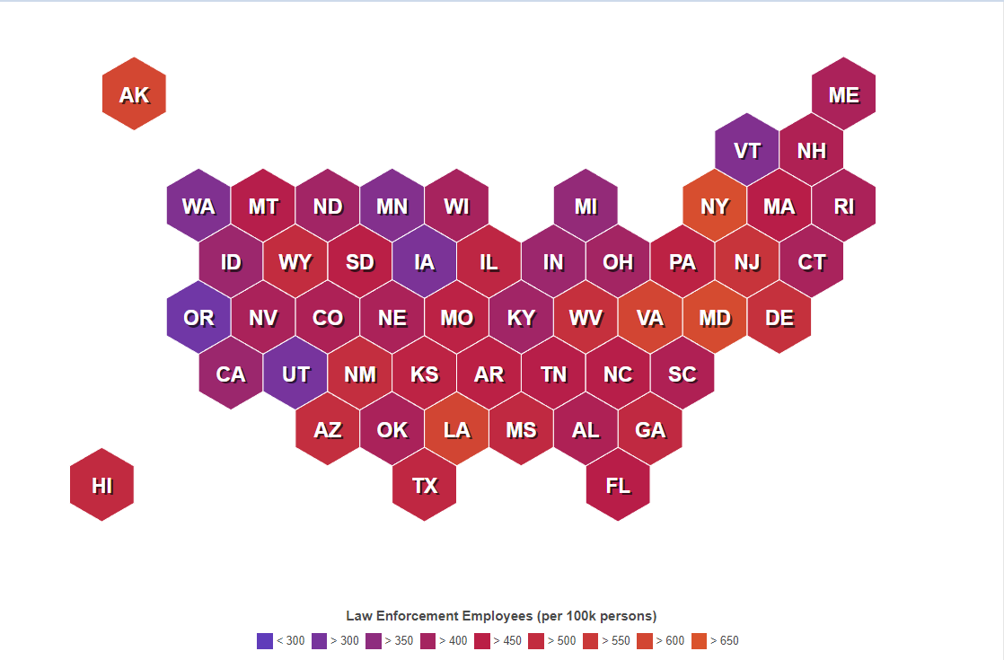
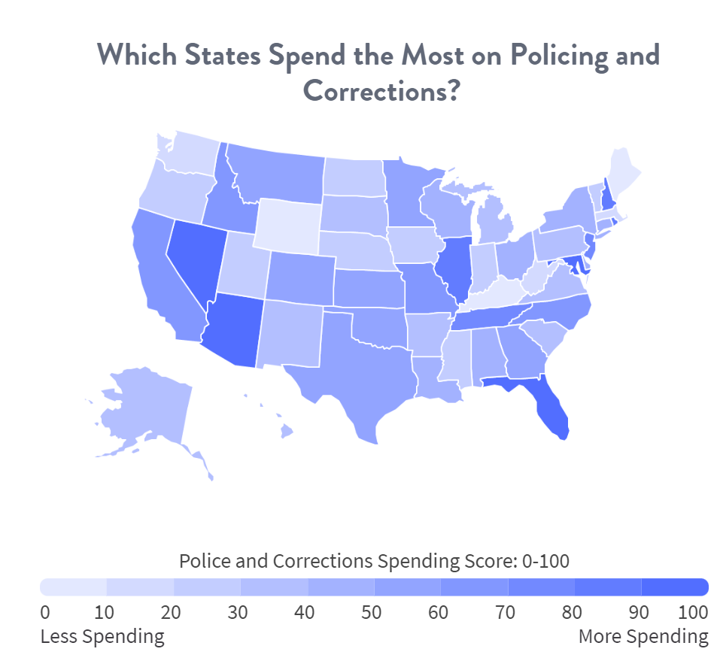
New Data (2/3): State Law Enforcement
We added two datasets about every state’s law enforcement:
Law Enforcement Officers Per 100,000 Citizens (Left)
Law Enforcement Spending per capita (Right)
Source: https://worldpopulationreview.com/state-rankings/police-officers-by-state
Source: https://www.moneygeek.com/living/state-policing-corrections-spending/

Slide 9
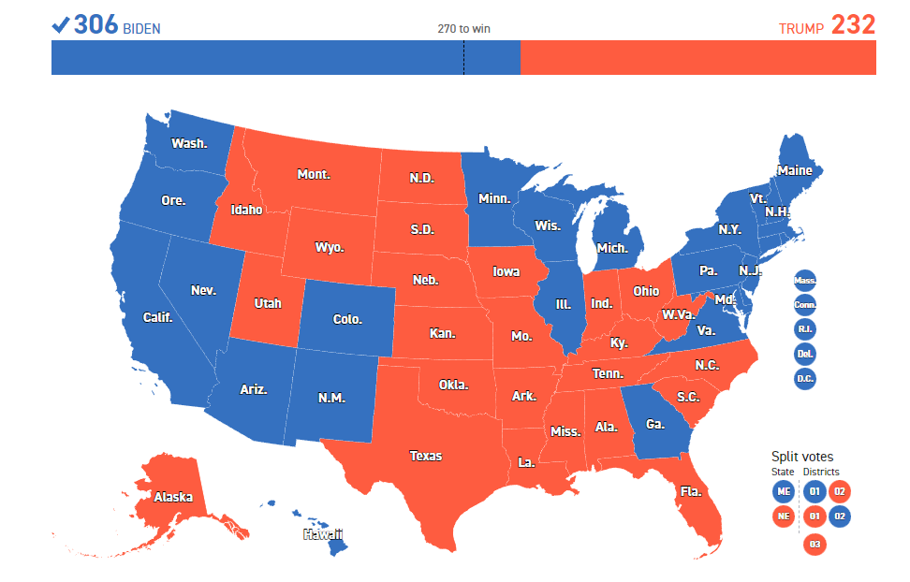
New Data (3/3): 2020 Victory Margin
To Account for Socio-Political Differences in the culture of each state, we added data from the 2020 Presidential Victory Margin
Source: https://www.politico.com/2020-election/results/president/

Slide 10
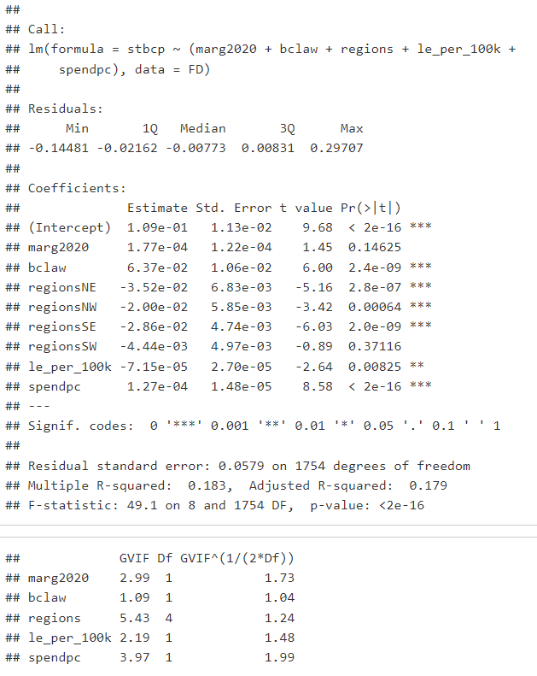
Model-1
The VIF values for this model is within acceptable range. With an R^2 of 0.183, this model is not very good at predicting statewide body camera usage. We can see that the region variable is not helpful so we will remove it.

Slide 11
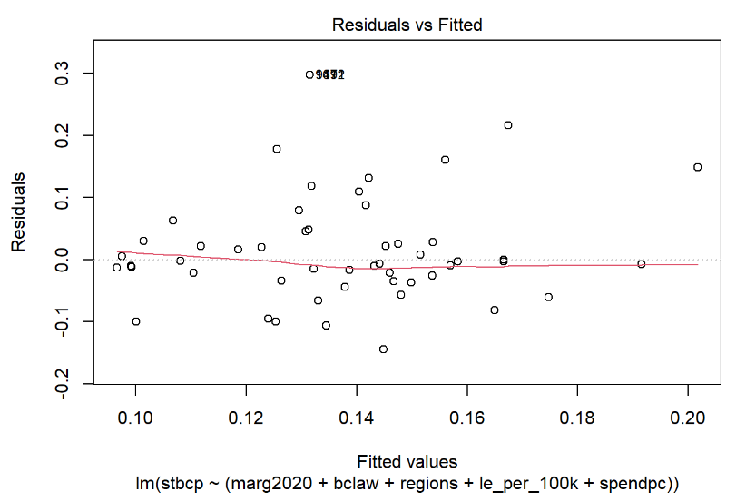
Residual VS Fitted

Slide 12
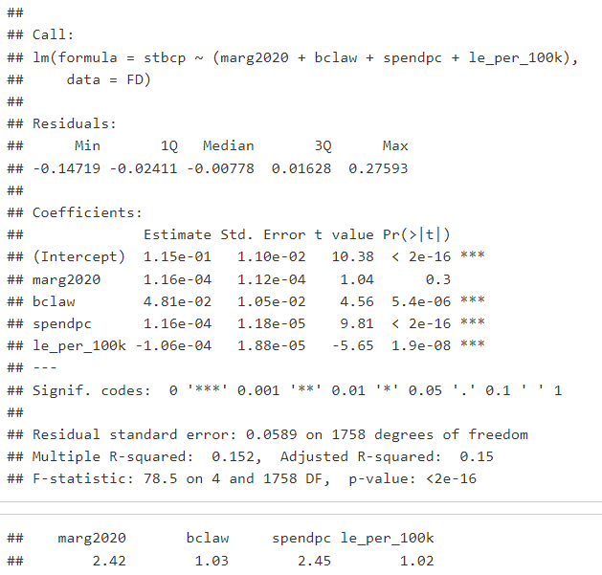
Model-2
The VIF values for model 2 are all within acceptable range. With an R^2 of 0.152, this model is even worse at predicting statewide body camera usage.

Slide 13
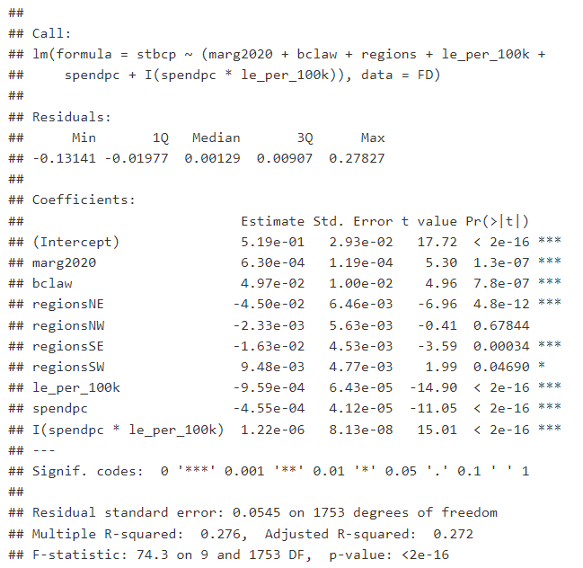
Model-3
Let us try analyzing the interaction of law enforcement spending per capita and officers per capita.
We are ignoring the VIF test for multicolinearity because we are using an interaction predictor. With an R^2 of 0.276, this model is not good, much better than the others at predicting statewide body camera usage.

Slide 14
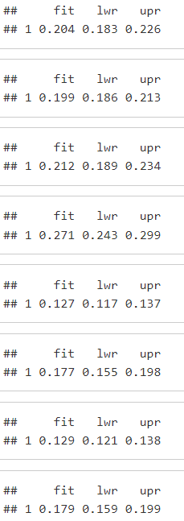
Predicting New Data
New State A:
Since lm3 is our best model (per our R^2), lets try to predict a few made up New US states
We can see the difference of fit on states E and F as well as G and H and see the effect body camera laws have.
New State B:
New State C:
New State D:
New State E:
New State F:
New State G:
New State H:

Slide 15
CORA CONCLUSION GOES HERE

Slide 16
Questions?

